Slide 1
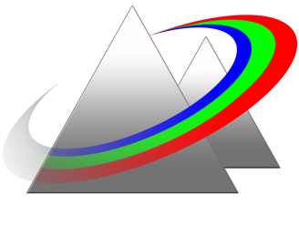

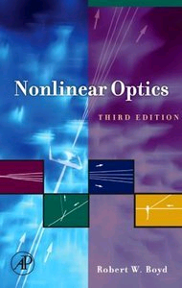
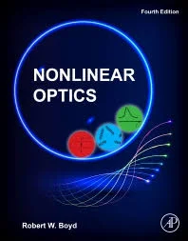
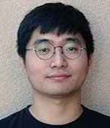
University of New Mexico
PHYC/ECE 568: NONLINEAR OPTICS
Spring 2022
Textbook
Instructor: Mansoor Sheik-Bahae
Office: PAIS, Room 2220
Phone: 226-3693 e-mail: msb@unm.edu
Office Hours: Make an appointment or stop by
.
The final grade is weighted as follows:
Midterm Exam: 45%
Final Project (paper + presentation): 40%
Homework: 15% (nearly every 2 weeks)
4th edition
TA: Mingyang Zhang
myzhang@unm.edu

Slide 2
Course Syllabus
Introduction (historical overview, applications of NLO) Nonlinear Susceptibilities (χ⁽²⁾ and χ⁽³⁾ processes, nonlinear refraction and absorption) Classical Anharmonic Oscillator Model Properties of Nonlinear Susceptibilities (symmetries, Kramers-Kronig dispersion relations) Wave Propagation in NLO Media (coupled amplitude equations for χ⁽²⁾ processes, phase matching, second harmonic generation, sum and difference frequency generation, optical parametric processes, cascading nonlinearities) Quantum Mechanical Treatment of Nonlinear Susceptibilities χ⁽³⁾ Processes (electronic, vibrational and rotational effects, optical Kerr effect, self-focusing, wave-mixing, bistability, phase-conjugation, beam coupling, solitons) Photo-Refractive Nonlinearities Stimulated Light Scattering (stimulated Raman, Brillouin, and Rayleigh scattering) Recent advances in ultrafast NLO (high-harmonic generation, atto-physics, terahertz)

Slide 3


What is Nonlinear Optics?
At low intensities light beams cross without any interaction (linear optics)
$${P=ε}_{0}χ^{\left(1\right)}E$$
${∇ }^{2}E−\frac{1}{c^{2}}\frac{∂^{2}E}{∂t^{2}}$=$μ_{0}\frac{∂^{2}P}{∂t^{2}}$
Light beams interact with each other, or themselves at high intensities (nonlinear optics)
$$P=ε_{0}(χ^{\left(1\right)}E+χ^{\left(2\right)}E^{2}+χ^{\left(3\right)}E^{3}+…)$$
ω₁
ω₂
ω₁ ± ω₂, 2ω₁ , 2ω₂ , 3ω₁ , …
wave mixing
Primary Manifestations:
sum, difference, harmonic frequency generation (new frequencies)
modulating refractive index and absorption coefficient; examples:

Slide 4
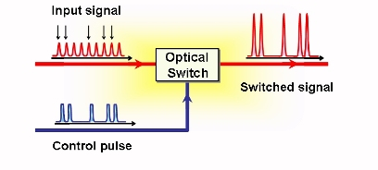
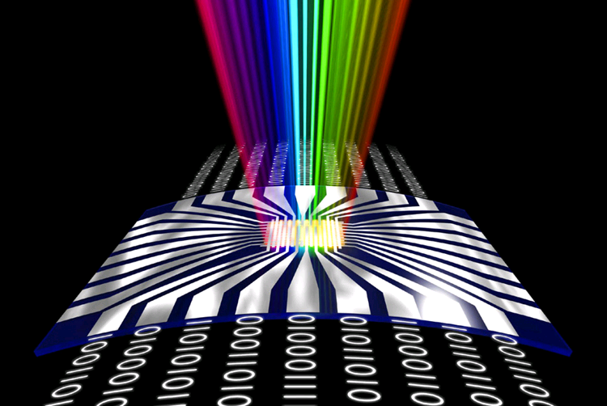
Controlling Light with Light
Optical Computers !

Slide 5
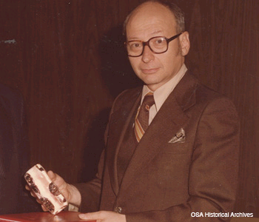
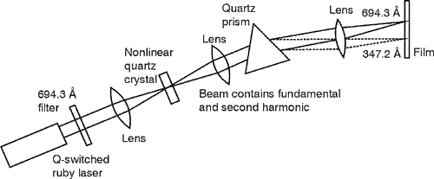

1961: Second Harmonic Generation
60th Anniversary of Nonlinear Optics
$$P=ε_{0}χ^{\left(2\right)}E^{2}$$
University of Michigan
Peter Franken (1929-1999)

Slide 6
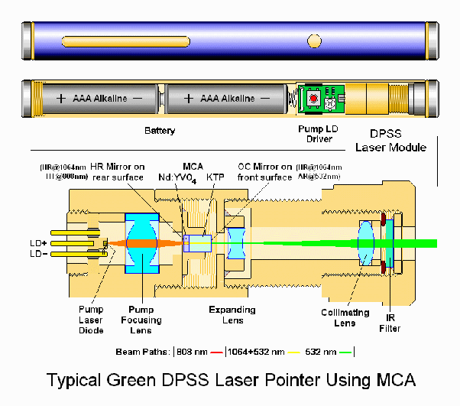
Second Harmonic Generation (SHG): Green Laser Pointer

Slide 7
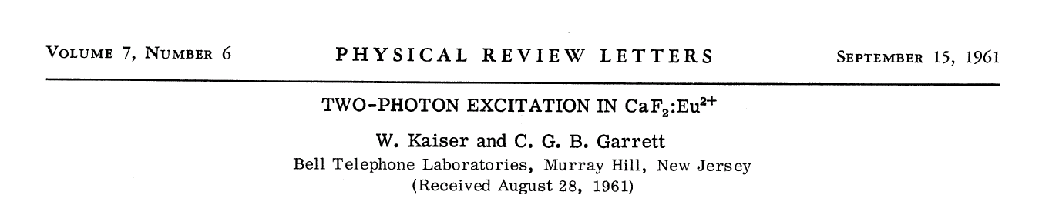
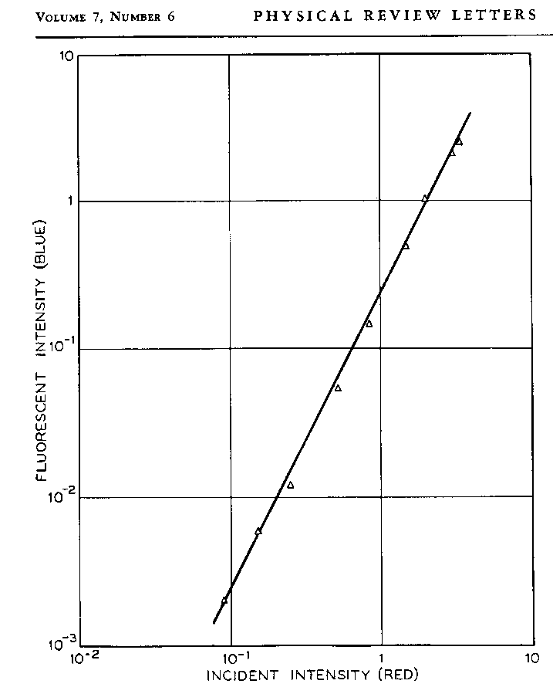
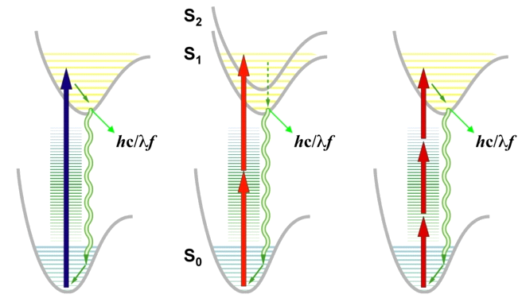


1961: two-photon absorption
60nd Anniversary of Nonlinear Optics
$$P=ε_{0}χ^{\left(3\right)}E^{3}$$
$$α=α_{0}+βI$$
Two-photon absorption
Linear (one-photon)
fluorescence
Two-photon
fluorescence (TPF)
Three-photon
fluorescence (3PF)

Slide 8
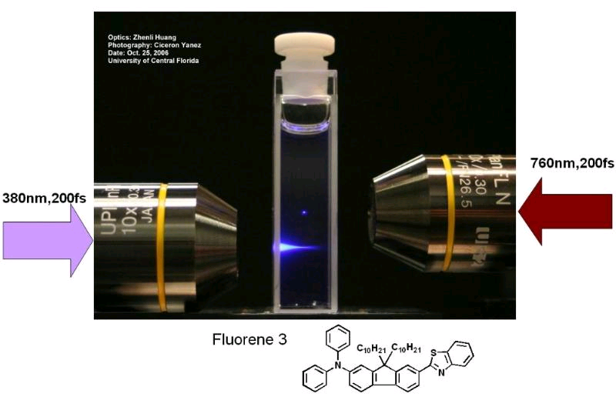
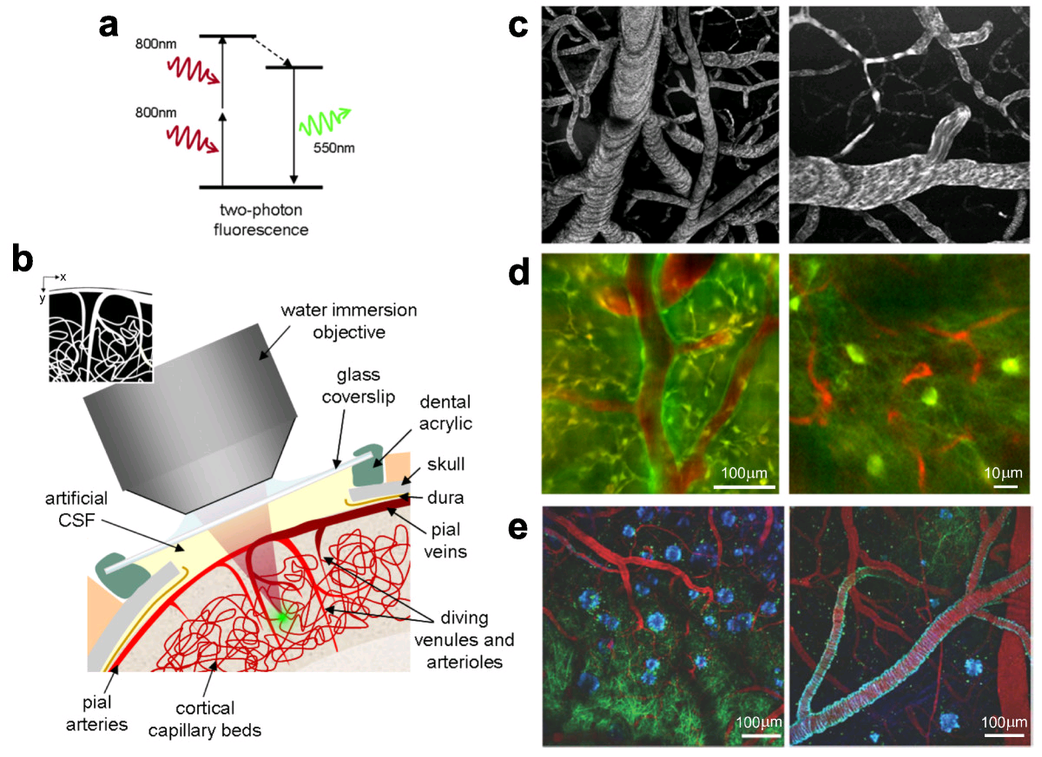
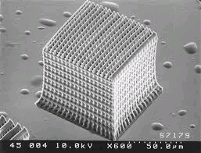
Two-photon microscopy
Two-photon polymerization

Slide 9
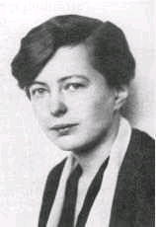
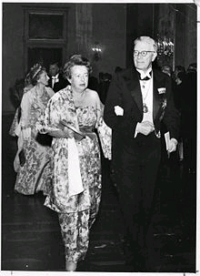
Theoretical Foundations
Maria Goeppert-Mayer (June 28, 1906 – February 20, 1972)
Two-photon absorption theory (1931, doctoral dissertation)
hν
hν
Awarded the Nobel Prize in Physics in 1963, shared with J. Hans D. Jensen and Eugene Paul Wigner.

Slide 10
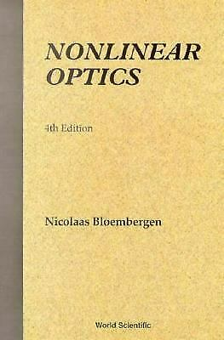
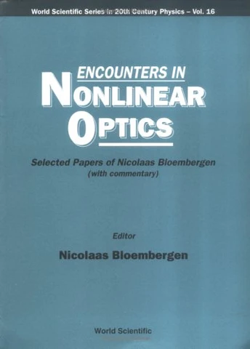
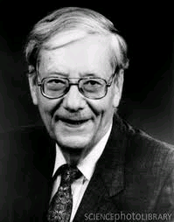
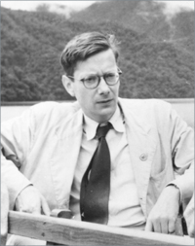
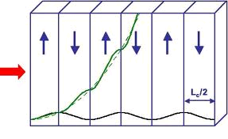
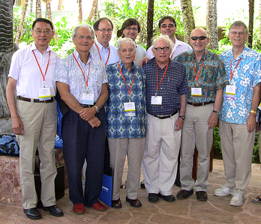
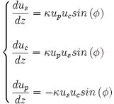
Theoretical Foundations
Nicholas Bloembergen
1962- 2017
Nobel Prize in Physics, 1981
(July 2011) in Hawaii (NLO Meeting)

Slide 11
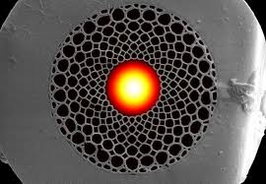
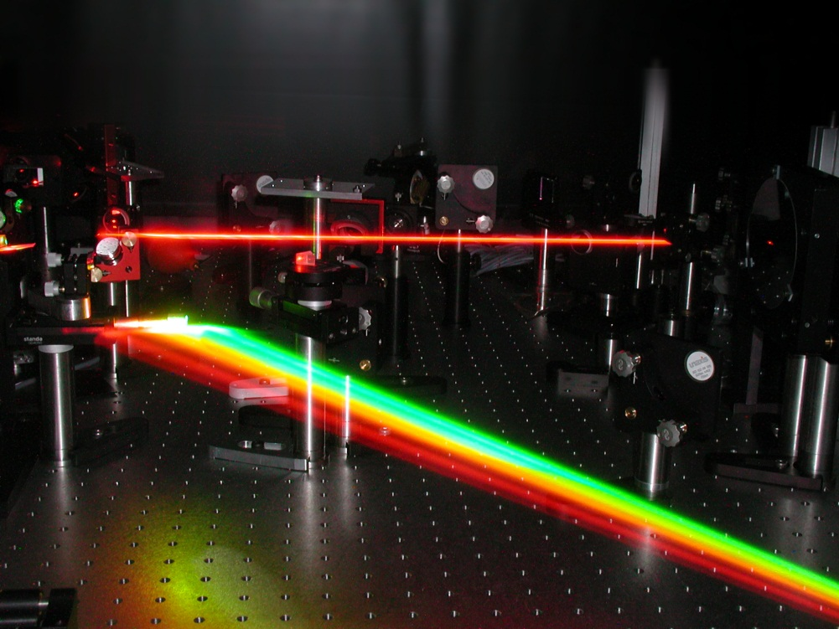
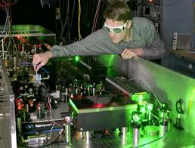
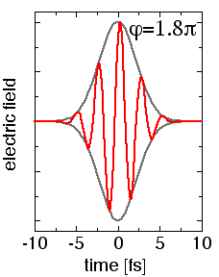
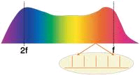
NLO: A thriving field with multiple application
Femtosecond Lasers, Frequency Combs and Optical Clocks

Slide 12
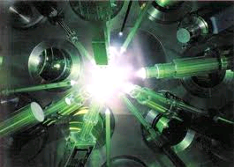
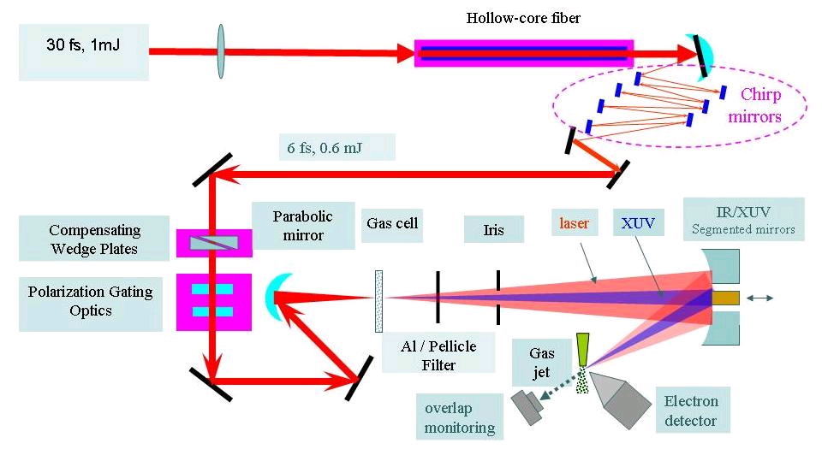
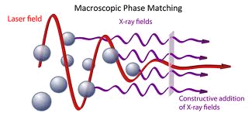
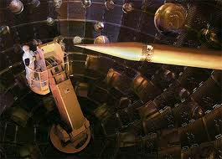
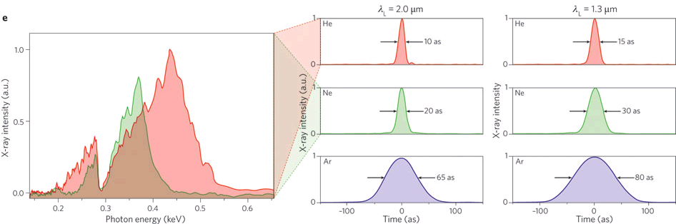
Extreme Nonlinear Optics (X-ray bursts, attosecond pulses, and laser fusion)

Slide 13
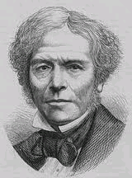
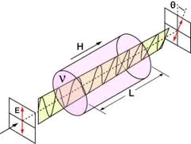
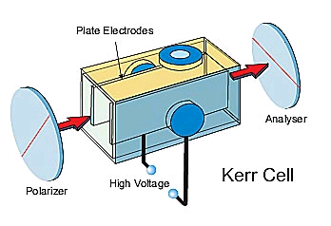
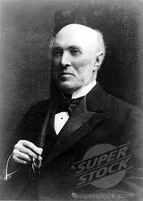
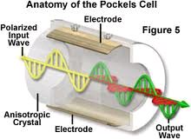
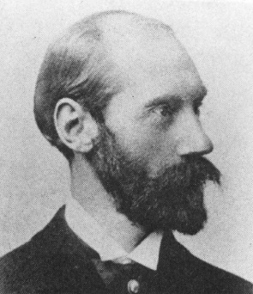



Other Historical Perspectives (19th Century)
Michael Faraday
Faraday Effect (magneto-optic) - 1845:
$$B$$
$$θ=V×B×L$$
$$V is the Verdet constant$$
John Kerr
Kerr Effect- 1875:
Pockels Effect- 1893:
Friedrich Pockels

Slide 14
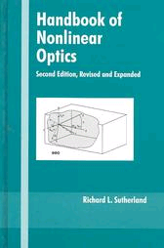
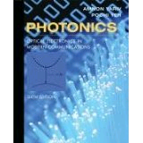
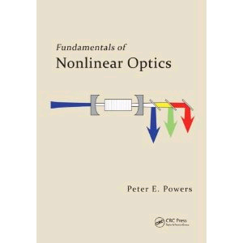
Other References
Handbook of Nonlinear Optics
Richard Sutherland
Photonics: Optical Electronics in Modern Communications
Amnon Yariv and Pochi Yeh
Fundamentals of Nonlinear Optics
Peter Bowers

